Slide 1
Big Mountain – Case Study

Slide 2

How can Big Mountain Ski Resort Capitalize on its current pricing strategy?
By Increasing Ticketing Prices?
How does Big Mountain Ski Resort’s prices compare with the market Segment
What are the most important factors that impact ticket prices?
By Reducing Costs?
Is Reducing the number of chairs Profitable?
What is the optimal number of chairs to remove

Slide 3
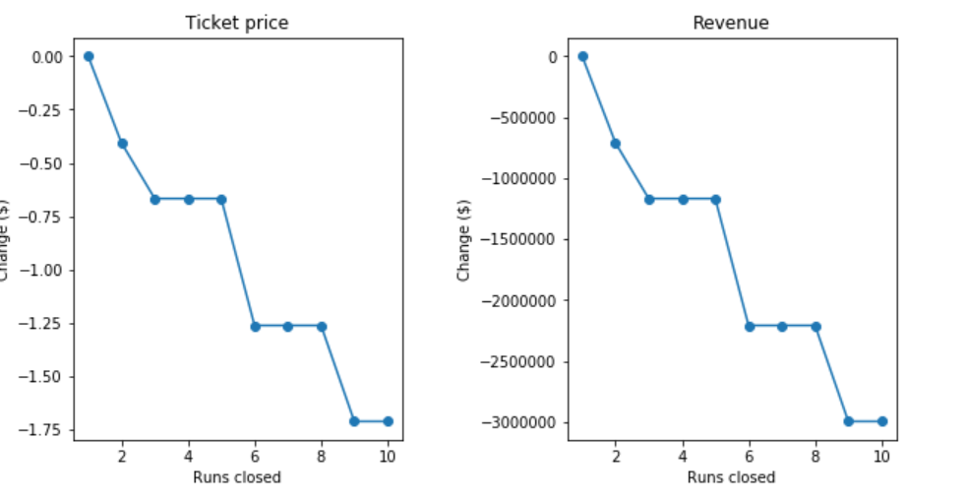
Recommendations
Increase ticket prices from $81 to $87
Reduce 5 runs that are least used
Invest in increasing the Vertical Drop
Spending on increasing the size of the runs is a wasted spend

Slide 4
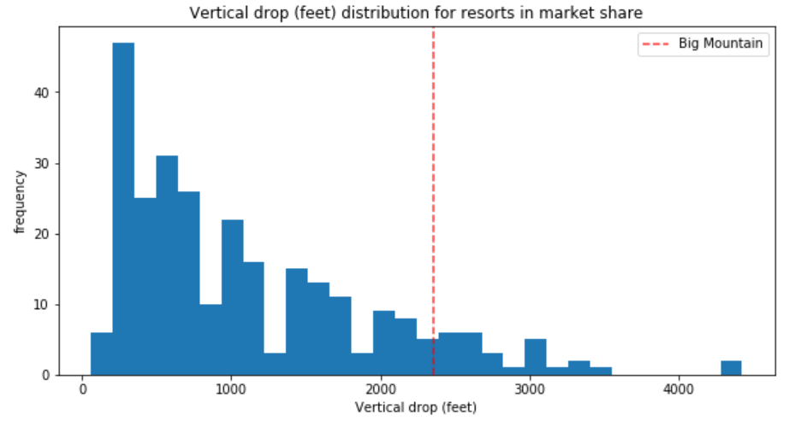
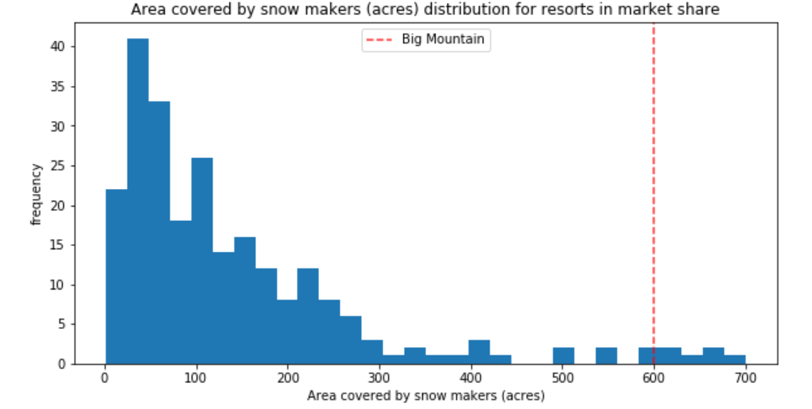
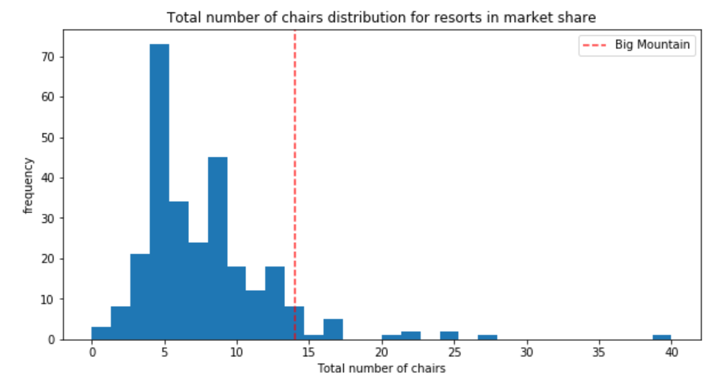
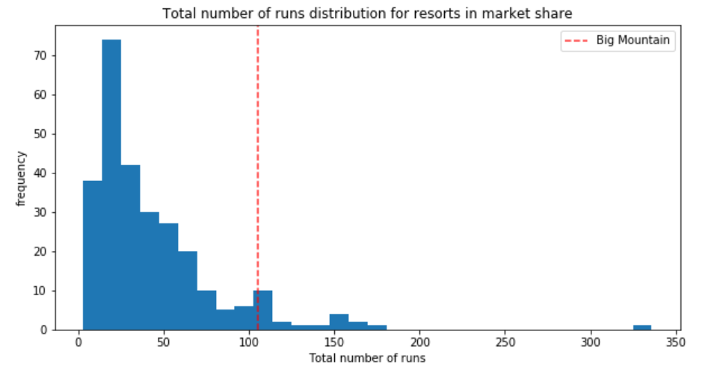
Market Context

Slide 5
Modeling
Linear Regression
Random Forest Regressor
Model | Linear Regression | Random Forest
Mean Absolute Error | $11 | $9.5
R-Squared | 63% | 70%
We decided to use the Random Forest Regressor because of the low Mean absolute error and better prediction on the Test dataset

Slide 6
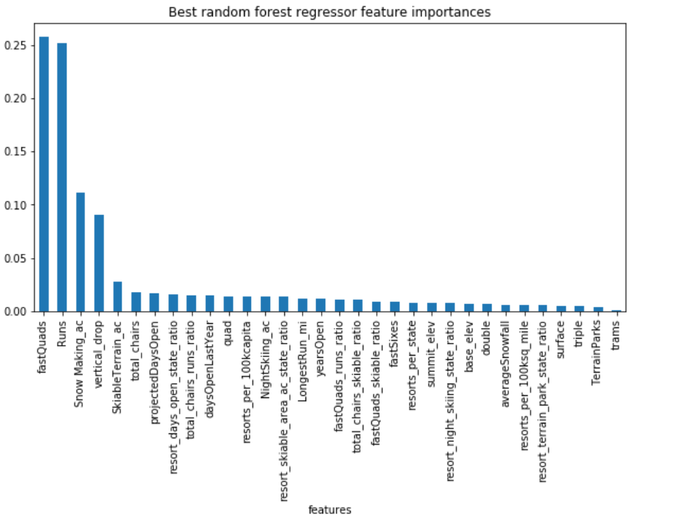
Feature Importance

Slide 7
Scenario Planning
Cost Cutting by reducing the number of runs
The model predicts that closing one run makes no difference. Closing 2 and 3 successively reduces support for ticket price and so revenue. If Big Mountain closes 3 runs, it seems they may as well close 4 or 5 as there's no further loss in ticket price. Closing 6 or more runs leads to a large drop in Revenue
Increasing the Vertical Drop
If you were to increase the Vertical Drop by 150 feet, you can charge $8.5 extra on the ticket prices. This will amount to almost $14 million in increased sales revenue assuming that there are 350,000 visitors expected every year and stay for 5 days.

